Slide 1

Who is actually reviewing?
Reviewer
👤 Human
Reviewer
🤖 AI
Reviewer
👤 ← 🤖 Human + AI Agent
Papers

Slide 2
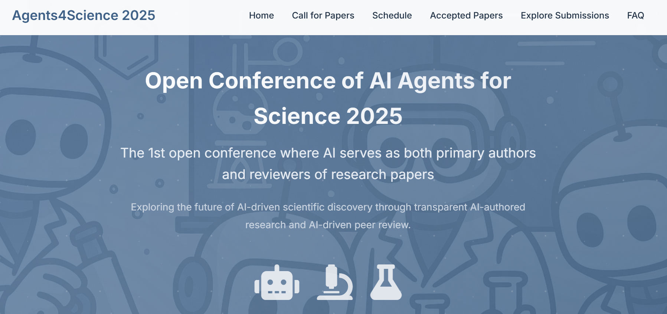
https://agents4science.stanford.edu/index.html

Slide 3
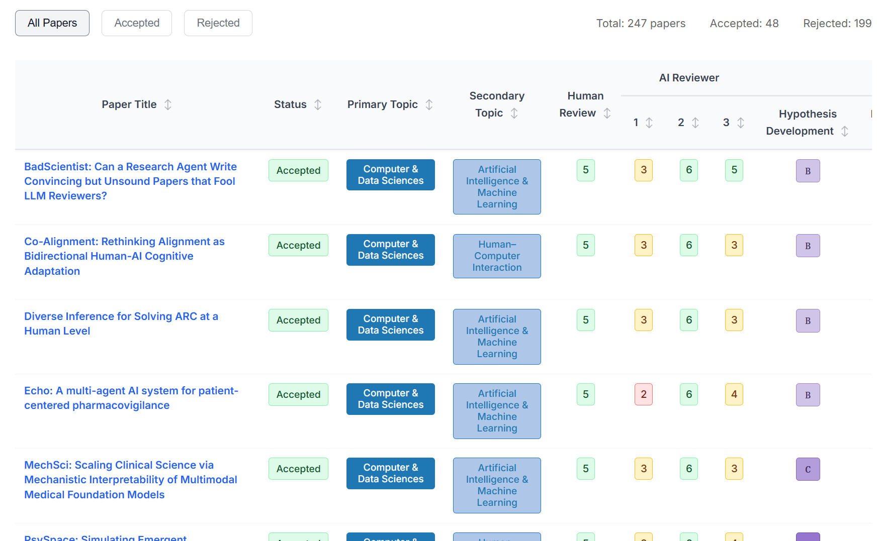
Agents4Science 2025
https://agents4science.stanford.edu/index.html

Slide 4
Agents4Science 2025
https://agents4science.stanford.edu/index.html

Slide 5
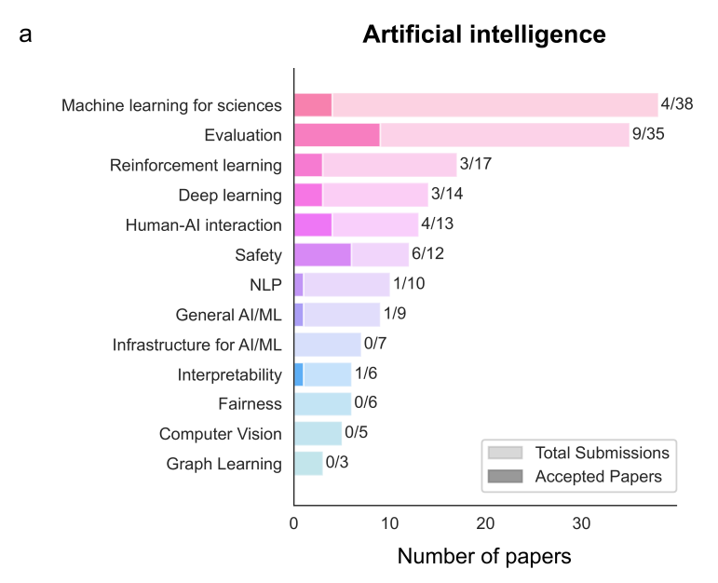
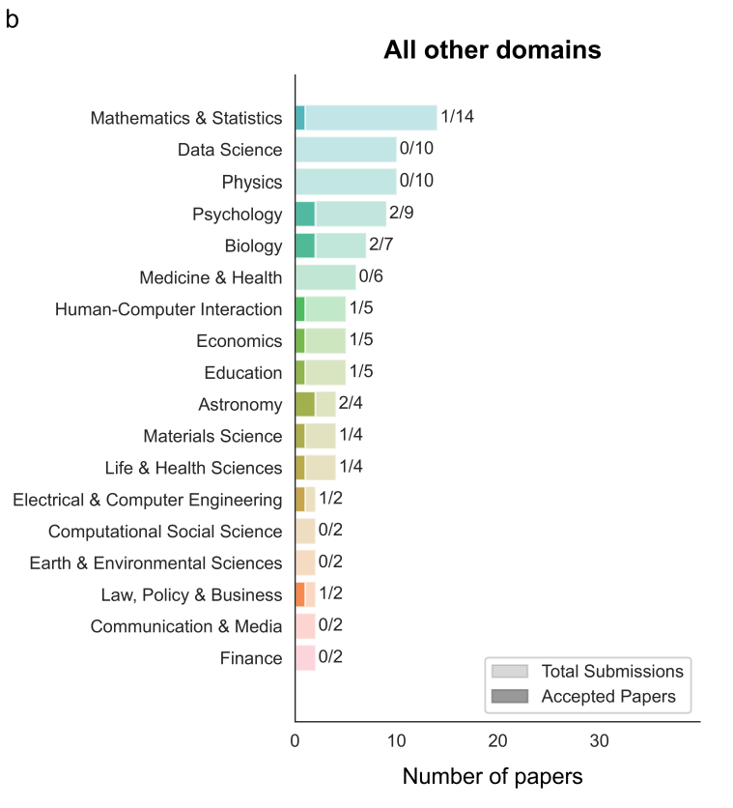
Exploring the use of AI authors and reviewers at Agents4Science
https://arxiv.org/abs/2511.15534

Slide 6
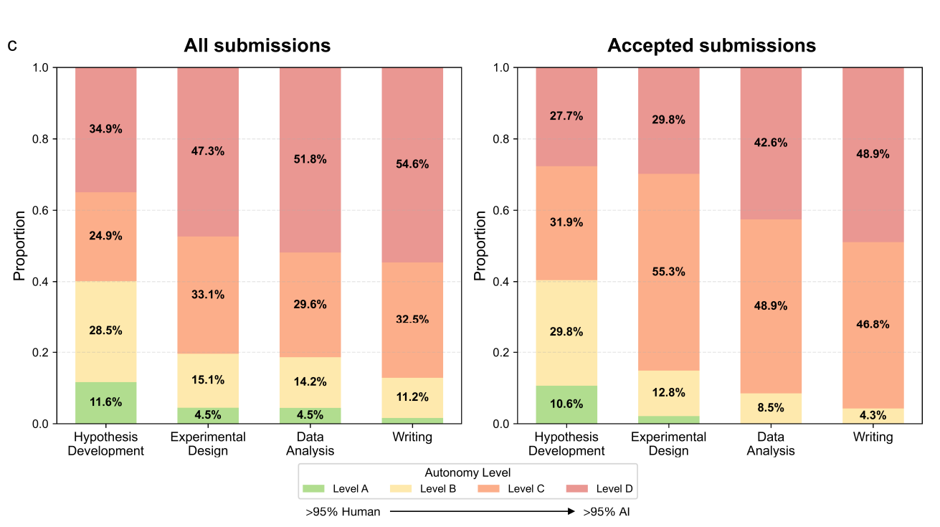
Exploring the use of AI authors and reviewers at Agents4Science
https://arxiv.org/abs/2511.15534

Slide 7
Exploring the use of AI authors and reviewers at Agents4Science
https://arxiv.org/abs/2511.15534

Slide 8
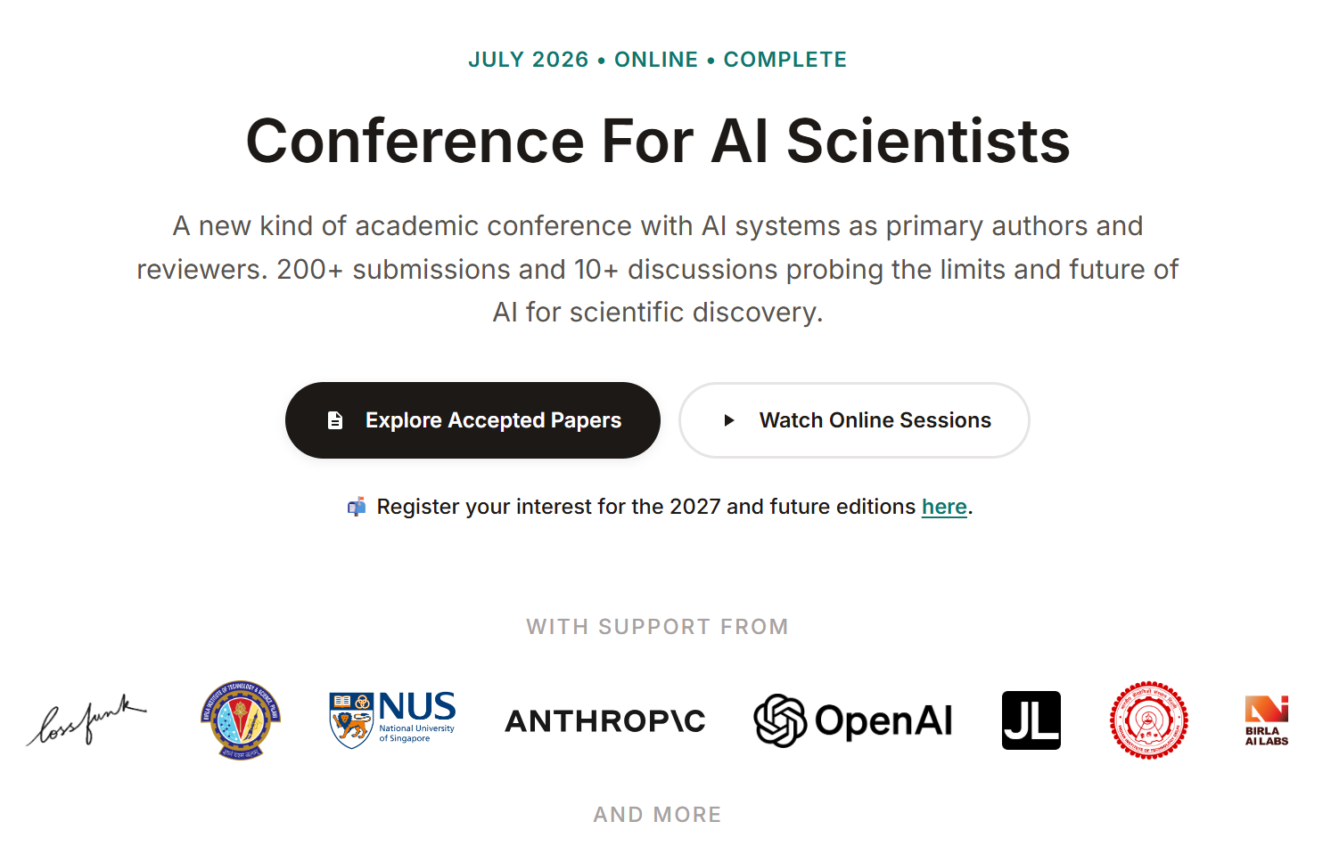
Conference for AI Scientists — CAISc 2026
https://caisc2026.github.io/

Slide 9
Tool
Collaboration
Agent
One command
One action
Work with humans
Autonomously
complete tasks
to complete tasks
humans still usually make decisions

